Slide 1
CPE 301
Lab #4 – The LED & GPIO Lab

Slide 2
Contents:
LEDs
Schematics & Symbols
Arduino Pins, Ports, and Pinouts
Arduino Library

Slide 3
LEDs
V = I * R
Short Pin / Flat side = Cathode
Anode = ( + )
Cathode = ( - )
Positive potential difference from Anode to Cathode = LIGHT
Overcurrent = POP, then smoke

Slide 4
Schematics & Symbols
Schematics
Hand-draw then scan or use CAD:
Circuitmaker
steep learning curve, but TONS of features
very similar to professional software (Altium Designer)
Circuit-diagram.org
super easy
in browser

Slide 5
Schematics & Symbols
Rules of Thumb
Labels, Labels, Labels
Put positive supply on top
Put ground on bottom

Slide 6
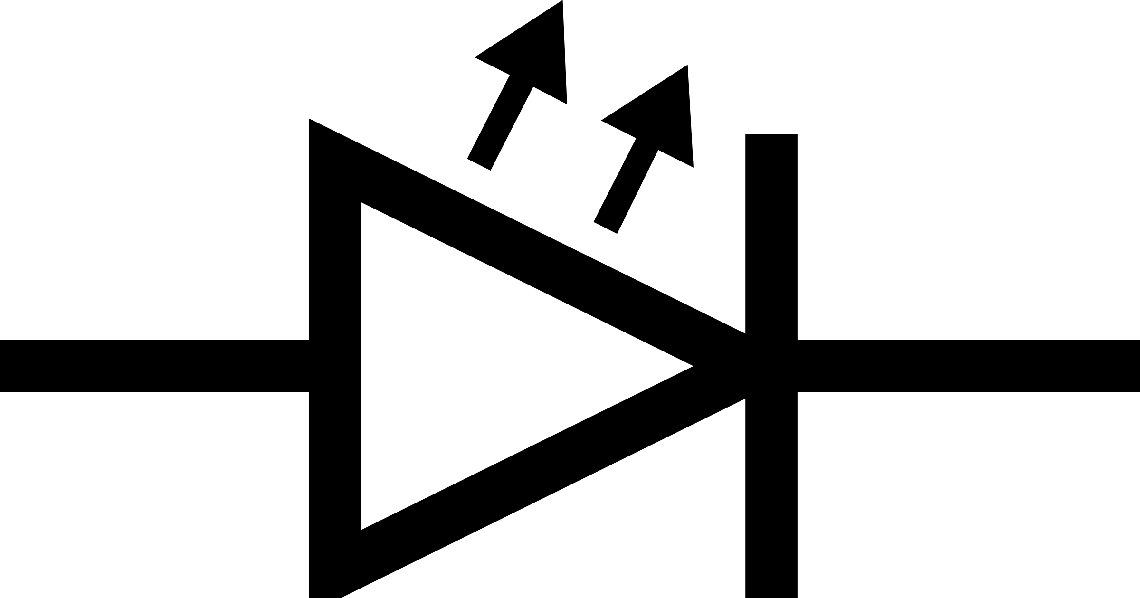
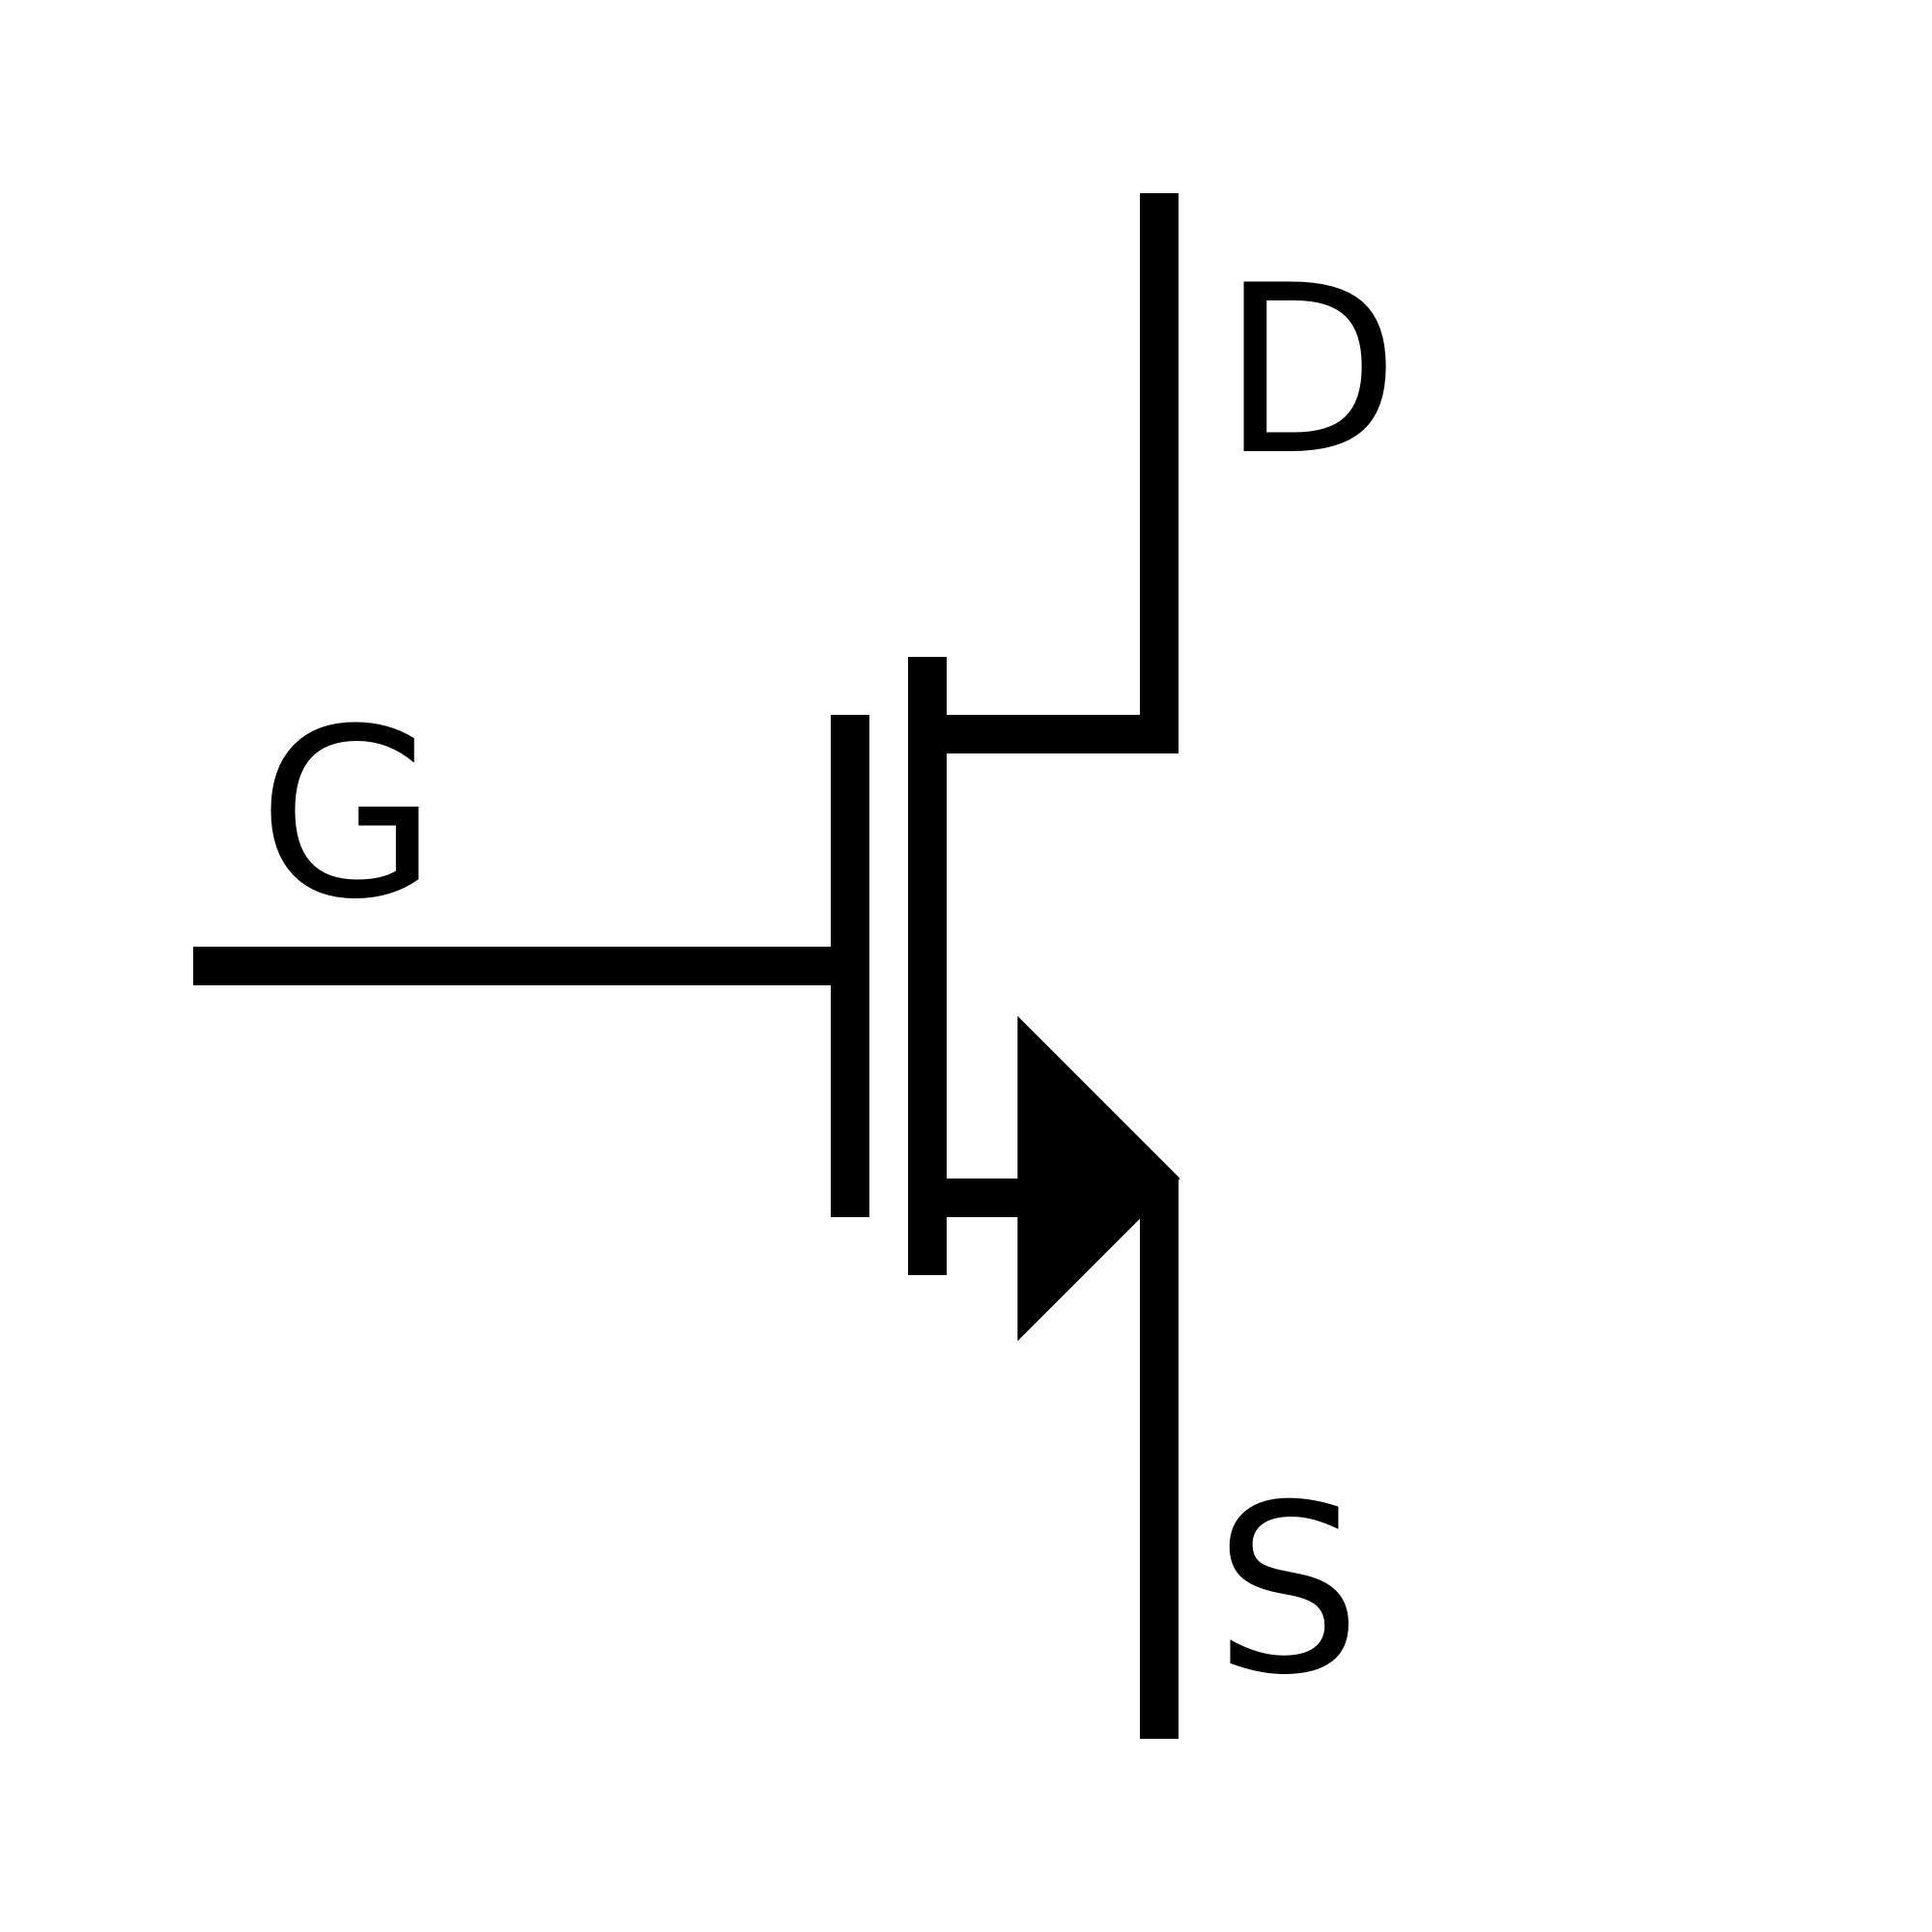


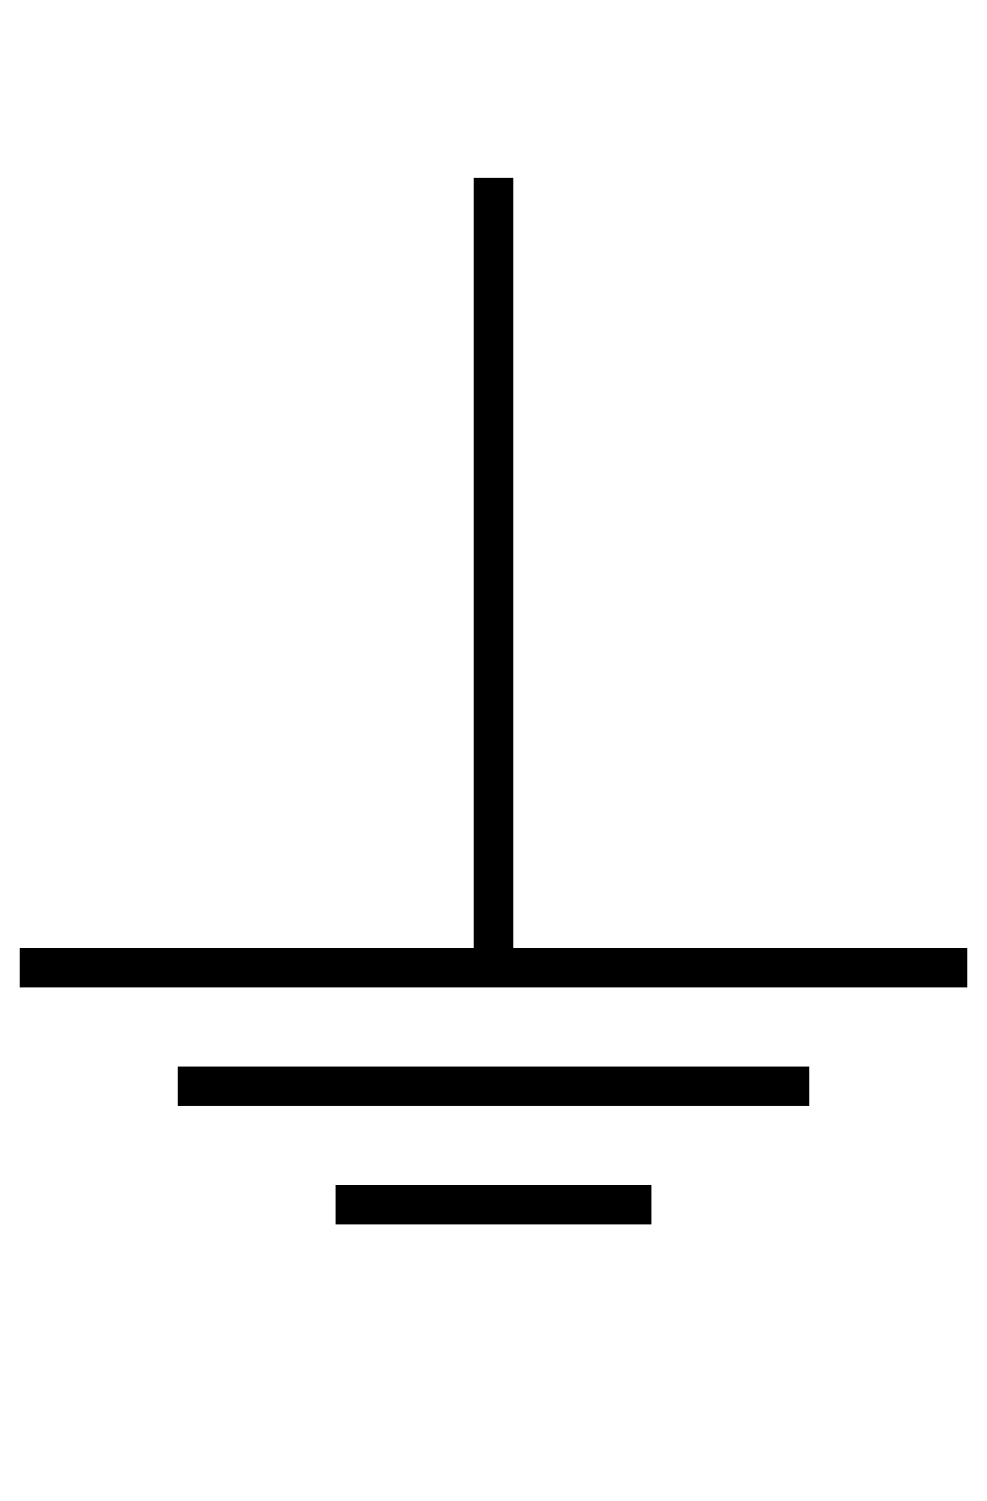

Schematics & Symbols
Symbols
LED
MOSFET
RESISTOR
VCC
Ground
Button

Slide 7
Arduino Pins, Ports, and Pinouts
Arduino is a Development Platform
Easy to use
simplifies the more complex aspects of programming microcontrollers
IDE & Libraries
Simple IDE with integrated USB uploader
Abstracted libraries
Atmel 2560 is a Microcontroller which Arduino uses in the Mega
8 bit commercial microcontroller
Very simple architecture
Simple Memory Mapped I/O

Slide 8
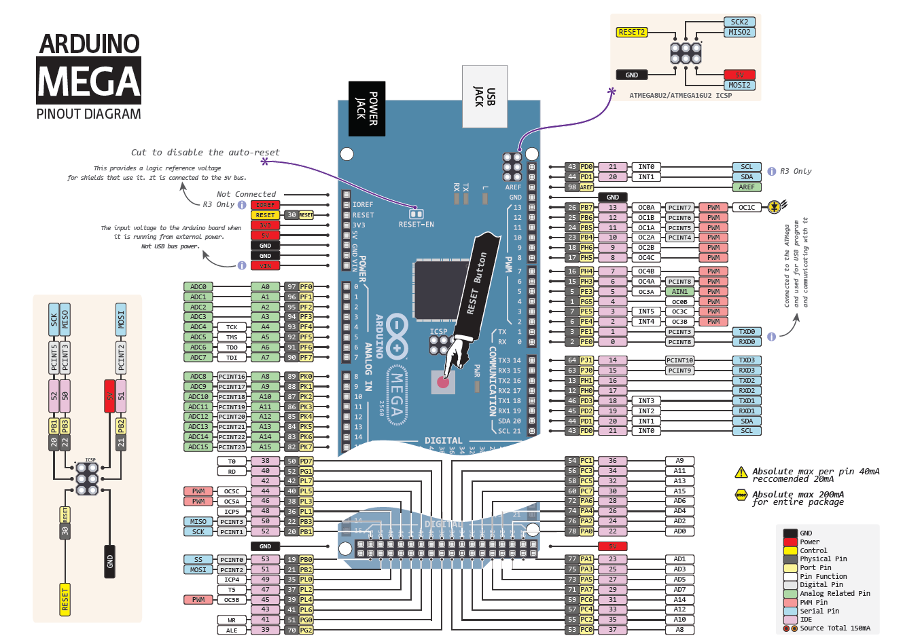
Arduino Pins, Ports, and Pinouts
Every I/O Pin:
Arduino Pin # (1-54, A0-A15)
Port Name/Number
Can have many different funcitons
Arduino Pin #s:
Labeled on the board
Work with Arduino Library Functions
Uniform Across all Arduino boards
Atmel 2560 Ports
Specific to the microcontroller
Allow direct access to hardware = ultimate control

Slide 9
Arduino Library
Basic Functions:
# | Name | Description | Parameters
1 | pinMode | Sets up pin for input or output | Pin # INPUT/OUTPUT/INPUT_PULLUP
2 | digitalWrite | Sets state of output pin | Pin # HIGH/LOW
3 | digitalRead | Reads state of input pin | Pin #
4 | delay | Waits a number of milliseconds | # of milliseconds

Slide 10
Arduino Library
RULES FOR THE REST OF THE SEMESTER
After this lab -> NO ARDUINO LIBRARY (unless specifically stated)
Homework
Labs
Quizzes
Tests
Still ok to use for debugging…

